Slide 1


stock buybacks
are they detrimental to the financial health of a company?
nils marthiensen, neelesh bhalla, chiajung chang
Notes:
Michael Gordon. Stock Buybacks: Value Creation or Destruction? June 29, 2020, University of Maryland- College Park, Robert H. Smith School of Business <https://papers.ssrn.com/sol3/papers.cfm?abstract_id=3639389>

Slide 2
content
background & definition
effects on the financial statements
what does it mean for the shareholder?
motivation and benefits
drawbacks
associated opportunity costs
general implications
regulating buybacks
some recommendations

Slide 3
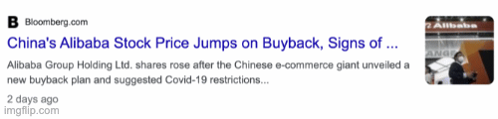
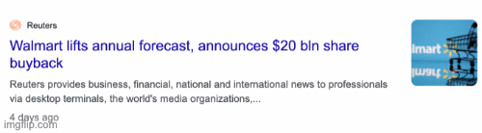

Slide 4


background
The amount of share repurchases taking place on an annual basis has reached incredible levels- nearly $1 trillion according to an estimate by Goldman Sachs (Nathan and Groman, 2019[2]).
3310 X
1 trillion of 100 dollar bills stacked together is equal to 3310 eiffel tower high.
Notes:
Nathan, Allison and David Groman. "Buyback Realities." 11 April 2019. Goldman Sachs Global Macro Research.
<https://www.goldmansachs.com/insights/pages/top-of-mind/buybackrealities/report.pdf>.

Slide 5
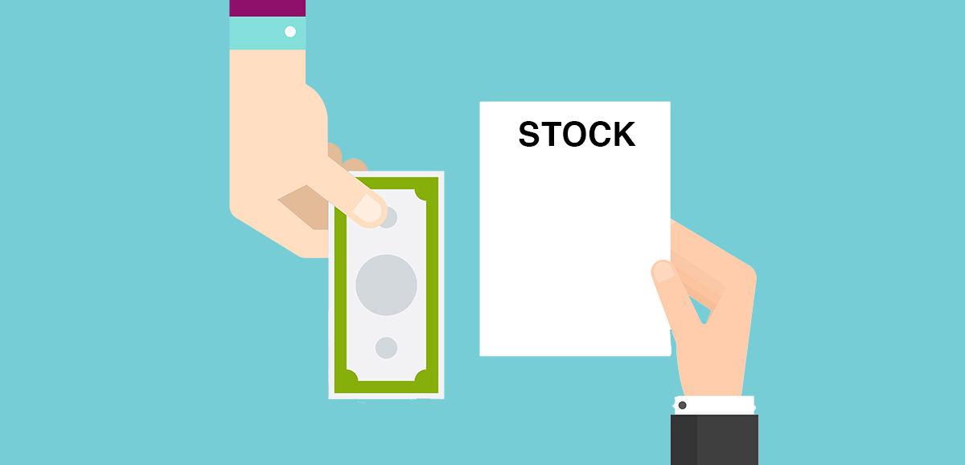
what is stock buyback?
When a company buys its own stock from the public stock market, thus reducing the number of shares available to other investors → Buyback!
Stock buybacks can have the effect of giving the impression of earnings growth when such growth is not actually present.
Notes:
https://papers.ssrn.com/sol3/papers.cfm?abstract_id=3639389

Slide 6
effects on the financial statements
 | Profit and Loss | Balance Sheet | Cash Flow
Cash financed | Reduces Net Income | Reduces Cash, Equity and Total Assets | Negative Financing Cash Flow
Debt financed | Reduces Net Income | Increases Debt Reduces Equity No change to Total Assets
Notes:
Why Financing?
Concerns the equity of the company, which is related to financing.
Why Negative?
If shares are removed from the market, the sum of all shares on the market decreases, thus decreasing the value of total equity of the company

Slide 7

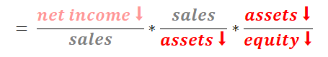
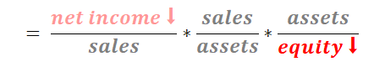
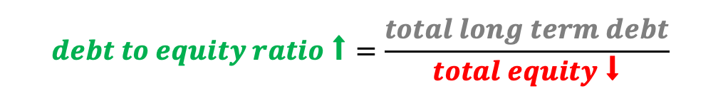
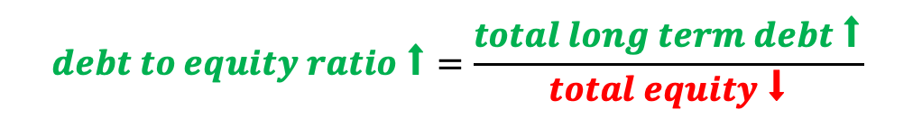
effects on financial ratios
cash-financed buyback
debt-Financed buyback
income statement and balance sheet
Notes:
working capital, interest coverage, total debt ratio, growth rate also impacted

Slide 8
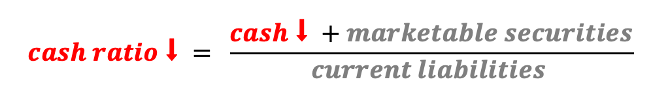
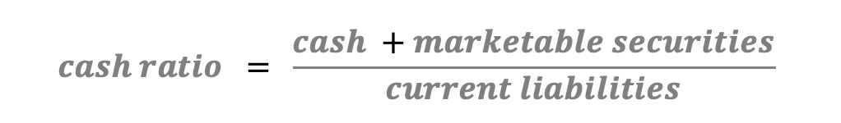
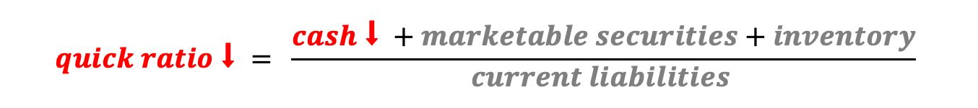
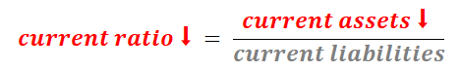
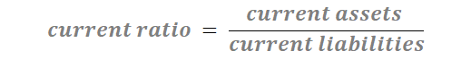
effects on financial ratios
cash-financed buyback
debt-Financed buyback
cash flow statement
Notes:
working capital, interest coverage, total debt ratio, growth rate also impacted
There are more, but this is a summary of the most important ones

Slide 9
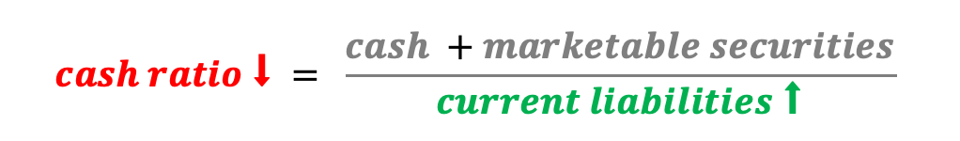
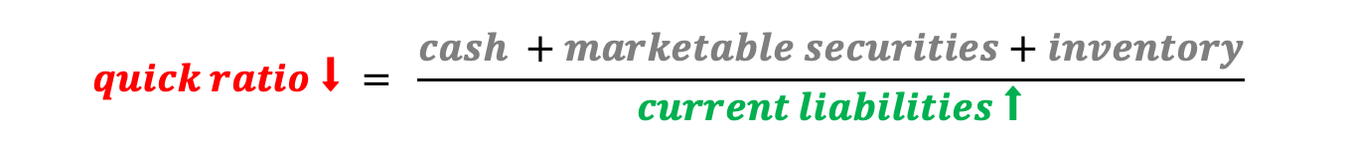
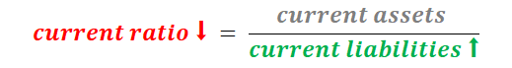
effects on financial ratios
cash-financed buyback
debt-Financed buyback
cash flow statement
Notes:
working capital, interest coverage, total debt ratio, growth rate also impacted
There are more, but this is a summary of the most important ones

Slide 10
effects on financial ratios
company A
pre-buyback data
Cash balance | $1,000,000
After-tax interest rate | 4%
Interest income | $40,000
Shares outstanding | 100,000
Price per share | $50.00
Total market value | $5,000,000
Net income | $400,000
EPS | $4.00
Price-earnings | 12.5
Earnings yield | 8.0%
post-buyback data |  | changes
Cash balance | $500,000 | ($500,000)
After-tax interest rate | 4%
Interest income | $20,000 | ($20,000)
Shares outstanding | 90,000 | (10,000)
Price per share | $55.56
Total market value | $5,000,000
Net income | $380,000 | ($20,000)
EPS | $4.22 | $0.22
Price-earnings | 13.16
Earnings yield | 7.6% | (0.4%)
𝐸𝑎𝑟𝑛𝑖𝑛𝑔𝑠 𝑌𝑖𝑒𝑙𝑑 > 𝐼𝑛𝑡𝑒𝑟𝑒𝑠𝑡 𝑅𝑎𝑡𝑒 → 𝐼𝑛𝑓𝑙𝑎𝑡𝑒𝑑 𝐸𝑃𝑆
Notes:
The earnings yield is calculated as the inverse of the Price-Earnings Ratio, which is calculated as the current stock price of the company divided by its EPS and is expressed as a percentage. More specifically:
Earning Yield = 1 / (Price / EPS) = EPS / Price = Net Income / Total Market Value

Slide 11
effects on financial ratios
company B
pre-buyback data
Cash balance | $1,000,000
After-tax interest rate | 4%
Interest income | $40,000
Shares outstanding | 100,000
Price per share | $50.00
Total market value | $5,000,000
Net income | $150,000
EPS | $1.50
Price-earnings | 33.3
Earnings yield | 3.0%
post-buyback data |  | changes
Cash balance | $500,000 | ($500,000)
After-tax interest rate | 4%
Interest income | $20,000 | ($20,000)
Shares outstanding | 90,000 | (10,000)
Price per share | $55.56
Total market value | $5,000,000
Net income | $130,000 | ($20,000)
EPS | $1.44 | ($0.06)
Price-earnings | 38.5
Earnings yield | 2.6% | (0.4%)
𝐸𝑎𝑟𝑛𝑖𝑛𝑔𝑠 𝑌𝑖𝑒𝑙𝑑 < 𝐼𝑛𝑡𝑒𝑟𝑒𝑠𝑡 𝑅𝑎𝑡𝑒 → 𝐷𝑒𝑓𝑙𝑎𝑡𝑒𝑑 𝐸𝑃𝑆
Notes:
The earnings yield is calculated as the inverse of the Price-Earnings Ratio, which is calculated as the current stock price of the company divided by its EPS and is expressed as a percentage. More specifically:
Earning Yield = 1 / (Price / EPS) = EPS / Price = Net Income / Total Market Value

Slide 12
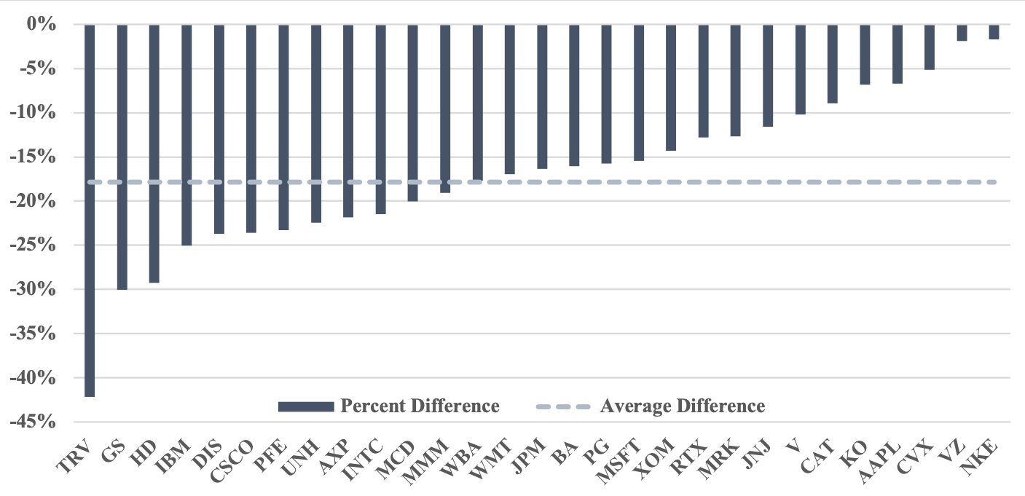
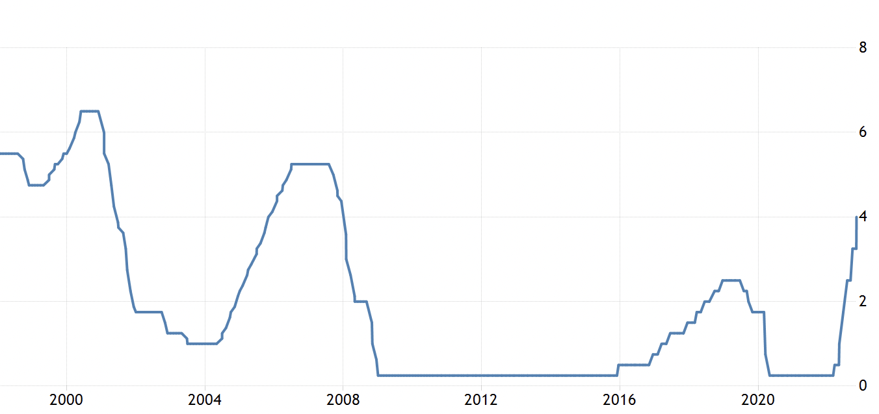
what does it mean for the shareholder?
a common thinking among investors and analysts → instituting a stock buyback program is in and of itself a positive and creates shareholder value;
this could be flawed thinking since it does not consider whether the company’s earnings are fundamentally growing in the absence of stock buybacks (Sherman, 2017[3]).
← interest rates were very low in the IIIIdepicted time frame, supporting XXinflated earnings per share
4%
2%
0%
US Federal Reserve Interest Rate from 2007 to 2021 [4]
Effect of stock buybacks on the 29 components of the DJIA indexed between 2010 and 2019 (WRDS data) [1]
Notes:
DJIA ≣ Dow Jones Industrial Average
Sherman, Leonard. "Why Are We in Business?." If You're in a Dogfight, Become a Cat! Strategies for Long-Term Growth. Columbia University Press, 2017
Michael Gordon. Stock Buybacks: Value Creation or Destruction? June 29, 2020, University of Maryland- College Park, Robert H. Smith School of Business <https://papers.ssrn.com/sol3/papers.cfm?abstract_id=3639389>
https://tradingeconomics.com/united-states/interest-rate

Slide 13

motivation & benefits
compensate management with stock options rather than cash payments
increased earnings per share (EPS)
reduced threat of hostile takeovers
management’s ability to give signals to investors
tax advantages
stock price increase (short-term)
Stock price is below book value
Notes:
increasing stock price resulting from a lower number of shares available to the market
Why leveraged buyback can be used as a means to fend off a hostile takeover? The company takes on significant additional debt to repurchase stocks through a buyback program. It Raises the share value (hopefully) and adding a great deal of unwanted debt to the company's balance sheet.

Slide 14

drawbacks
“Too many companies have cut capital expenditure and even increased debt to boost dividends and increase share buybacks… [which] can jeopardize a company’s ability to generate sustainable long-term returns”
Laurence Fink
CEO - BlackRock, Inc.
Buyback affect a company's credit rating if it borrows money to repurchase the shares.
Many companies finance stock buybacks because the loan interest is tax-deductible. However, debt obligations drain cash reserves.
Notes:
2014
https://www.reuters.com/article/us-blackrock-dividends-idUSBREA2P1C820140326
Negative effect on R&D
IBM has spent almost 60% more on stock buybacks than on
innovation and has bought back 40% more in stock than the company is currently worth

Slide 15



opportunity cost
Is a stock buyback an effective use of capital?
Might as well utilize the money somewhere else…
foregone investment
rainy day funds
dividends

Slide 16
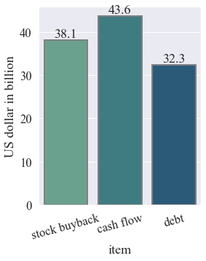
general implications
-5 US airlines spent about 87.3% of their cash flow on repurchasing stock 2010 to 2019
-To maintain operations, these same airlines debt funded 84.7% (worth of buybacks).
cheap debt after 2008 let buybacks explode but made companies vulnerable to even small economic shocks
Notes:
American Airlines, Alaska Airlines, Delta Airlines, Southwest Airlines, and United Airlines.
All needed government help during covid which could have been avoided

Slide 17
regulating buybacks
In 1982, the SEC adopted Rule 10b-18, which allowed companies to execute repurchases of their own common stock without violating the 1934 Act, as long as the structure of the transactions met four specific safe harbor requirements:
Manner of Purchase Condition: Companies can only use a single broker to submit an order to buy its stock.
Timing Condition: Companies may not make any purchases of their own stock during the first and last half hour of the trading day.
Price Condition: The SEC rule instituted a maximum price premium that a company can pay for its own stock.
Volume Condition: While there are varying rules for different types of Securities, the general rule for most companies is a maximum daily purchase of 25% of the average daily trading volume (ADTV) over the trailing four calendar week period.
Notes:
Electronic copy available at: https://ssrn.com/abstract=3639389
1. If a company submitted multiple stock orders with multiple brokers, it may give the appearance of higher demand for the stock than actually exists.
2. For companies in low trading volume
3. Can not be higher than the last transaction
The purpose of this rule is to prevent companies from artificially raising the price of their stock above where it would be based on natural market forces.
4. Average Daily Trading Volume (ADTV) is a technical indicator used by investors that refers to the number of shares of a particular stock that, on average, change hands during a single trading day.

Slide 18
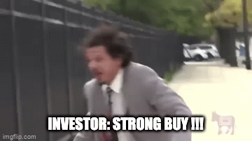

some recommendations
limit the amount of stock buybacks to the amount that companies grant to employees as equity compensation
buybacks may be taxed in the same manner as dividends, as they largely have the same result of increasing the value of an investor’s holdings
the SEC may impose restrictions and lower the amount of stock that can be repurchased by a company and its affiliated purchasers during a predetermined time period

Slide 19
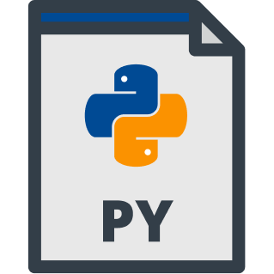

Slide 20
references
literature
Michael Gordon. Stock Buybacks: Value Creation or Destruction? June 29, 2020, University of Maryland- College Park, Robert H. Smith School of Business <https://papers.ssrn.com/sol3/papers.cfm?abstract_id=3639389>
Nathan, Allison and David Groman. "Buyback Realities." 11 April 2019. Goldman Sachs Global Macro Research. <https://www.goldmansachs.com/insights/pages/top-of-mind/buyback-realities/report.pdf>
Sherman, Leonard. "Why Are We in Business?." If You're in a Dogfight, Become a Cat! Strategies for Long-Term Growth. Columbia University Press, 2017.
https://tradingeconomics.com/united-states/interest-rate
https://sfmagazine.com/post-entry/september-2022-the-downsides-of-stock-buybacks/
https://www.investopedia.com/ask/answers/042015/why-would-company-buyback-its-own-shares.asp
github
https://github.com/nilsmart96/financial-effects-of-stock-buybacks

Slide 21
Thank you!
nils marthiensen, chiajung chang, neelesh bhalla

Slide 22
effects in the financial statements
→ Financed with excess cash
No impact to the income statement
Balance Sheet
Assets | Liabilities
… | Debt
Cash | Equity
Total | Total

Slide 23
effects in the financial statements
→ Financed with new debt
Interest payments rise in the income statement, reducing taxes, but also reducing net income
Balance Sheet
Assets | Liabilities
… | Debt
Cash | Equity
Total — | Total —

